Slide 1
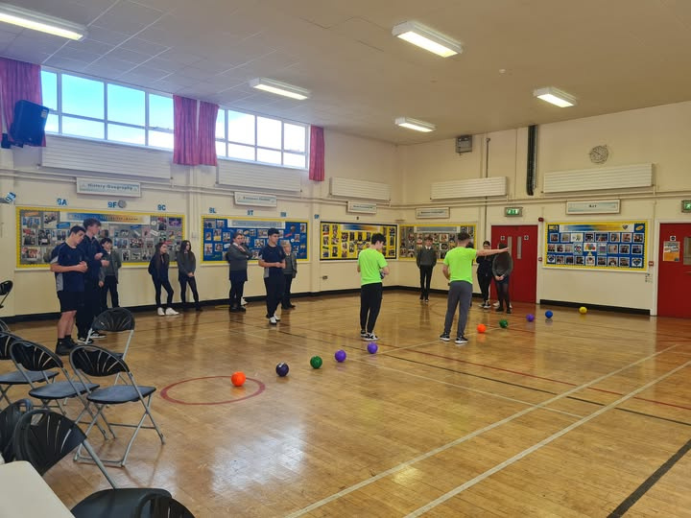




Our School & Take 5 Steps for Wellbeing
Notes:
Introduce each memeber.
Tell them this is a small workshop on the Take 5 Steps to Wellbeing.
Format:
Video about Take 5 Steps
Group Task
One person from each group will give some examples of ideas to promote Take 5 Steps to Wellbeing.

Slide 2



Slide 3




In teams of 4-5 how can you promote Take 5 Steps to Wellbeing.

Slide 4

1 member of each team - presents 1 idea for each of the Take 5 Steps

Slide 5


