Slide 1





Slide 2


Be Someone hero’s

Slide 3



Slide 4
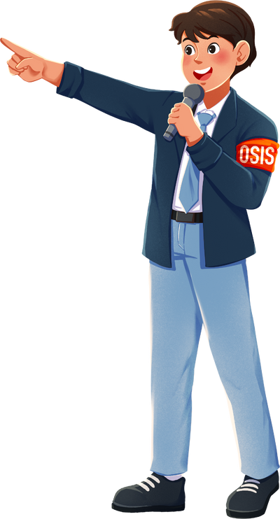

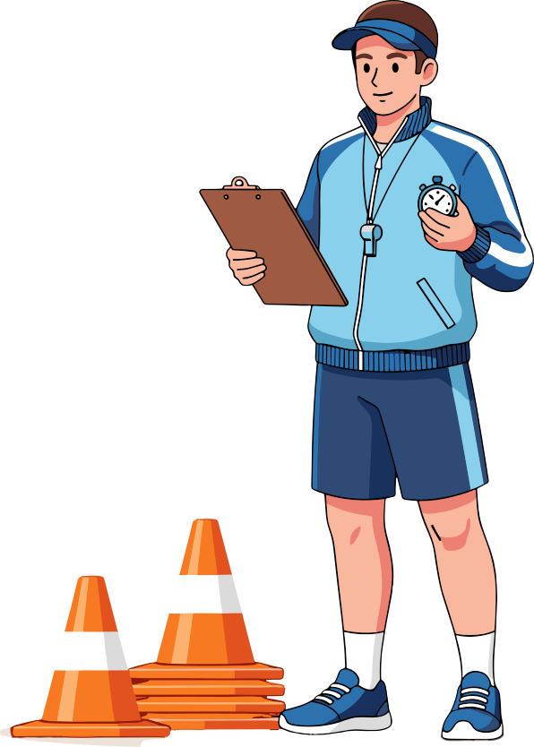




Youth Leader
Teacher
See Something
Say Something
Coach
Police
Friend
Family

Slide 5


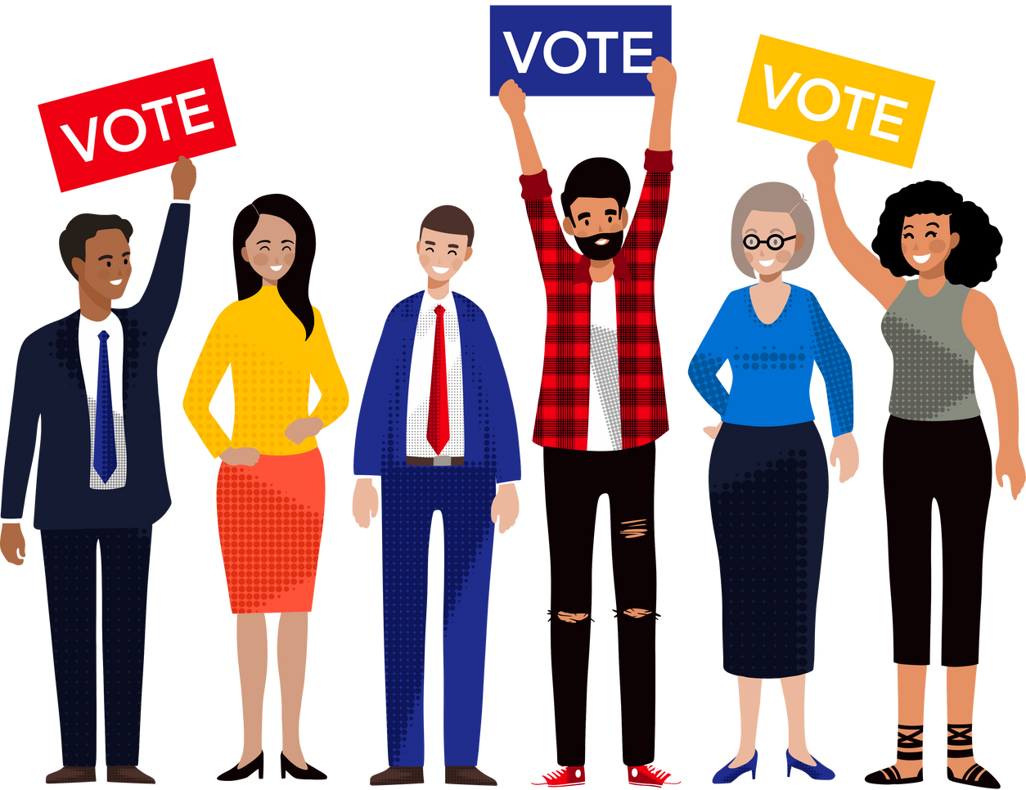


In Groups of 4-5
Design an Anti Bullying Campaign Poster
Pause the video

Slide 7

Nominate someone to present from each team

Slide 8



