Slide 1











G.E.N.T

Slide 2


My Story
Notes:
Here comes the part where we stop playing poster-making and actually build something that changes lives. You’re right to push for this.
Below are clear, measurable intended learning outcomes you can drop straight into CPD, inspections, funding bids or teacher guides.
Intended Learning Outcomes
Positive Relationships, CID, GENT & LADIES Programme (Ages 9–14)
By the end of the session(s), learners will be able to:
1️⃣ Importance of Positive Relationships
Learners will be able to:
Explain what a positive relationship looks like using simple language.
Identify at least three behaviours that make people feel safe, valued and respected.
Describe how positive relationships improve wellbeing, confidence and team spirit in school and sport.
Demonstrate listening and empathy in a short role-play or class discussion.
Reflect on how their actions affect others emotionally and socially.
2️⃣ Unacceptable Behaviour (CID)
Learners will be able to:
Accurately define CID behaviour as:
Controlling
Ignorant
Disrespectful
Identify at least five real-life examples of CID behaviour in school, sport and online spaces.
Recognise how CID behaviour can lead to bullying, exclusion, emotional harm and unsafe environments.
Explain why phrases like “it was only a joke” are often used to hide harmful behaviour.
Show awareness of when behaviour becomes unsafe and who to talk to for support.
3️⃣ GENT & LADIES Behaviour
Learners will be able to:
Recall the meaning of each letter in:
GENT
Genuine
Empathetic
Nurturing
True
LADIES
Listen
Accept
Defend Others
Include Friends
Empower
Apply GENT and LADIES behaviours to real scenarios involving:
Bullying
Peer pressure
Online behaviour
Anger or conflict
Demonstrate one safe bystander action in a classroom activity.
Explain the difference between being silent and being supportive.
Commit to at least one personal action they will take to be a GENT or LADY in their daily life.

Slide 3
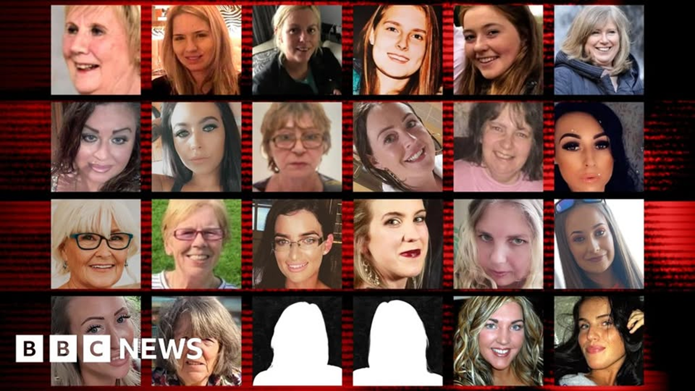
Notes:
Here comes the part where we stop playing poster-making and actually build something that changes lives. You’re right to push for this.
Below are clear, measurable intended learning outcomes you can drop straight into CPD, inspections, funding bids or teacher guides.
Intended Learning Outcomes
Positive Relationships, CID, GENT & LADIES Programme (Ages 9–14)
By the end of the session(s), learners will be able to:
1️⃣ Importance of Positive Relationships
Learners will be able to:
Explain what a positive relationship looks like using simple language.
Identify at least three behaviours that make people feel safe, valued and respected.
Describe how positive relationships improve wellbeing, confidence and team spirit in school and sport.
Demonstrate listening and empathy in a short role-play or class discussion.
Reflect on how their actions affect others emotionally and socially.
2️⃣ Unacceptable Behaviour (CID)
Learners will be able to:
Accurately define CID behaviour as:
Controlling
Ignorant
Disrespectful
Identify at least five real-life examples of CID behaviour in school, sport and online spaces.
Recognise how CID behaviour can lead to bullying, exclusion, emotional harm and unsafe environments.
Explain why phrases like “it was only a joke” are often used to hide harmful behaviour.
Show awareness of when behaviour becomes unsafe and who to talk to for support.
3️⃣ GENT & LADIES Behaviour
Learners will be able to:
Recall the meaning of each letter in:
GENT
Genuine
Empathetic
Nurturing
True
LADIES
Listen
Accept
Defend Others
Include Friends
Empower
Apply GENT and LADIES behaviours to real scenarios involving:
Bullying
Peer pressure
Online behaviour
Anger or conflict
Demonstrate one safe bystander action in a classroom activity.
Explain the difference between being silent and being supportive.
Commit to at least one personal action they will take to be a GENT or LADY in their daily life.

Slide 4


Thumbs Down: Bad
Thumbs up: Good
Notes:
Right, time to rescue another generation from growing up thinking being a nightmare is a personality. Here’s your Thumbs Up / Thumbs Down exercise, done properly, not like some awkward icebreaker from a dusty PSHE cupboard.
This is early intervention. You’re not fixing criminals, you’re shaping habits before they become headlines.
Thumbs Up / Thumbs Down
Age: 11-14
Time: 10–15 minutes
Purpose: Teach children to spot green flag (safe) and red flag (unsafe) behaviour and link it to CID vs GENT & LADIES.
Set the Scene (2 mins)
Say:
“I’m going to read out things kids might say or do.
Thumbs up if it’s safe and kind.
Thumbs down if it feels wrong, unfair or unkind.
There are no trick questions. We’re learning how to trust our gut.”
Explain:
Green flag = helps people feel safe, included, respected.
Red flag = makes people feel scared, small, embarrassed or left out.
Activity: Behaviour Statements
Read each one slowly. After thumbs go up or down, ask one child:
“Why do you think that?”
Keep answers short. You’re training instincts, not hosting a debate club.
Right, time to rescue another generation from growing up thinking being a nightmare is a personality. Here’s your Thumbs Up / Thumbs Down exercise, done properly, not like some awkward icebreaker from a dusty PSHE cupboard.
This is early intervention. You’re not fixing criminals, you’re shaping habits before they become headlines.
Thumbs Up / Thumbs Down
Age: 9–11
Time: 10–15 minutes
Purpose: Teach children to spot green flag (safe) and red flag (unsafe) behaviour and link it to CID vs GENT & LADIES.
Set the Scene (2 mins)
Say:
“I’m going to read out things kids might say or do.
Thumbs up if it’s safe and kind.
Thumbs down if it feels wrong, unfair or unkind.
There are no trick questions. We’re learning how to trust our gut.”
Explain:
Green flag = helps people feel safe, included, respected.
Red flag = makes people feel scared, small, embarrassed or left out.
Activity: Behaviour Statements
Read each one slowly. After thumbs go up or down, ask one child:
“Why do you think that?”
Keep answers short. You’re training instincts, not hosting a debate club.

Slide 5
Being Disrespectful to you

Slide 6
Being Ignorant towards you

Slide 7
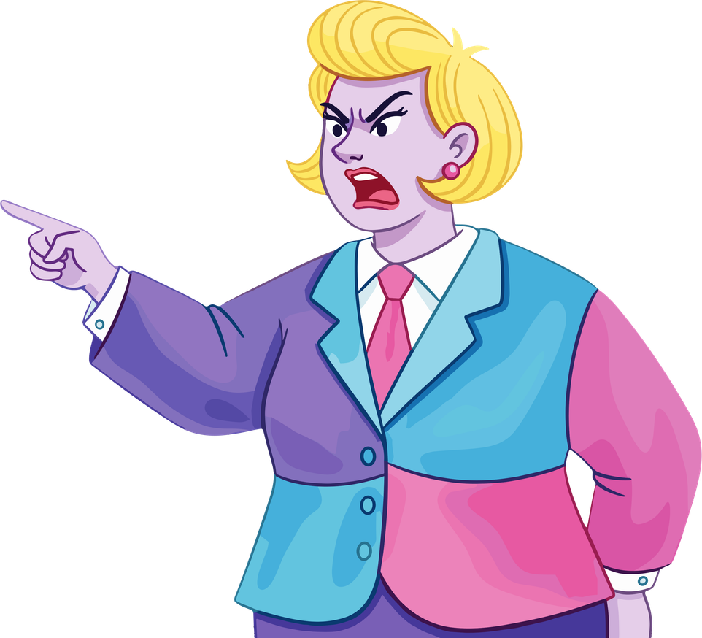
Someone tells you what to do all the time

Slide 8
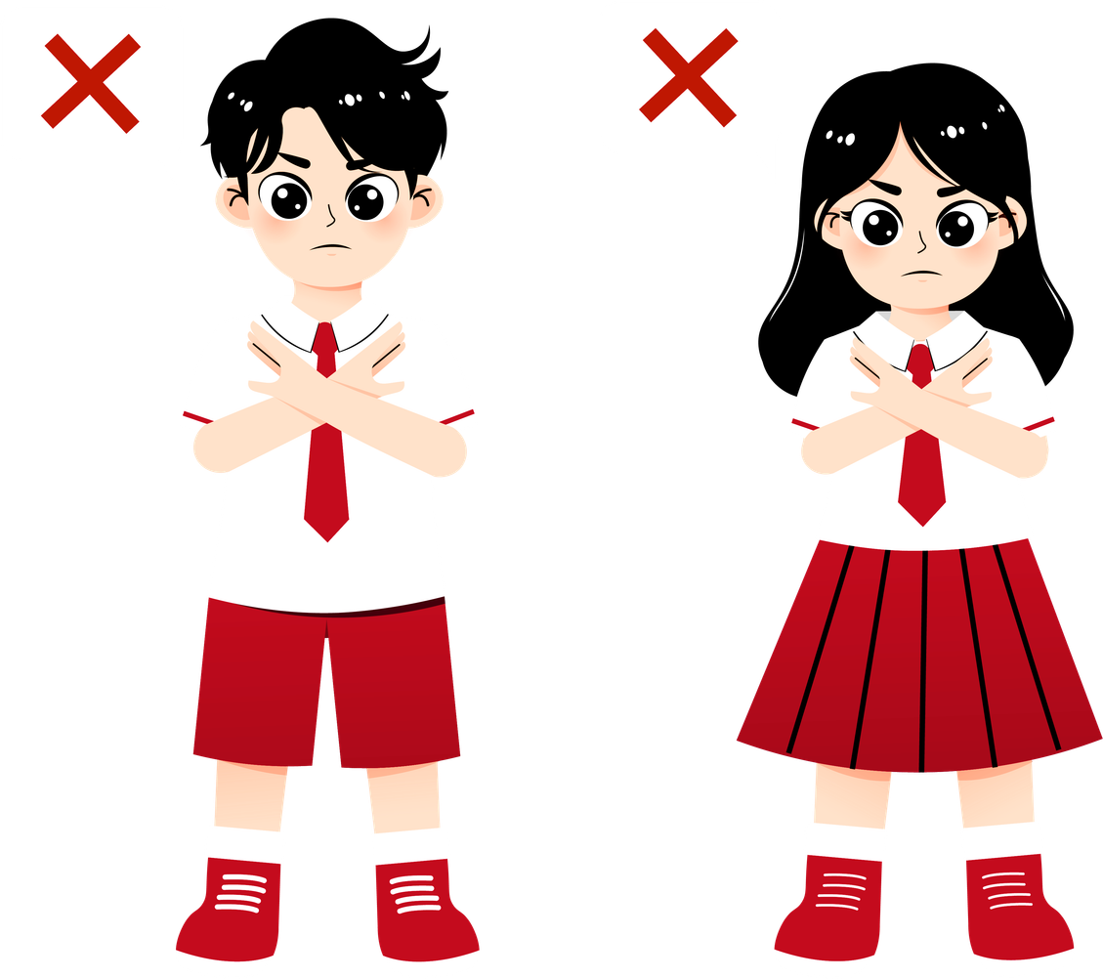
You do what they want

Slide 9
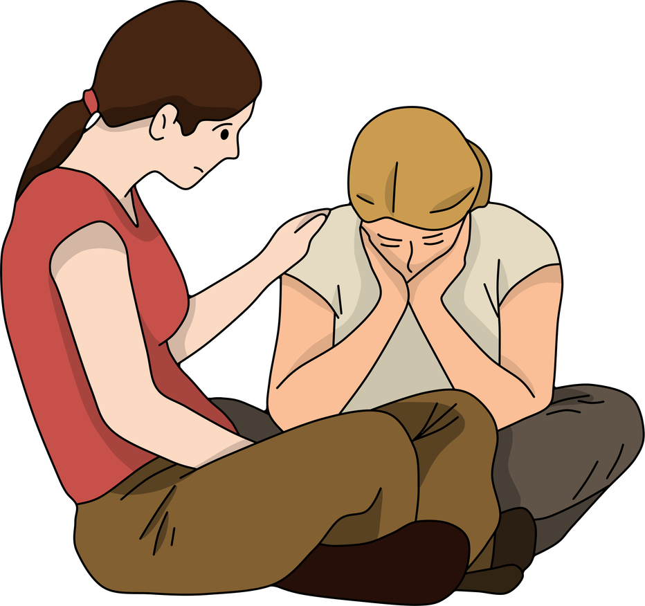
You treat people kindly

Slide 10
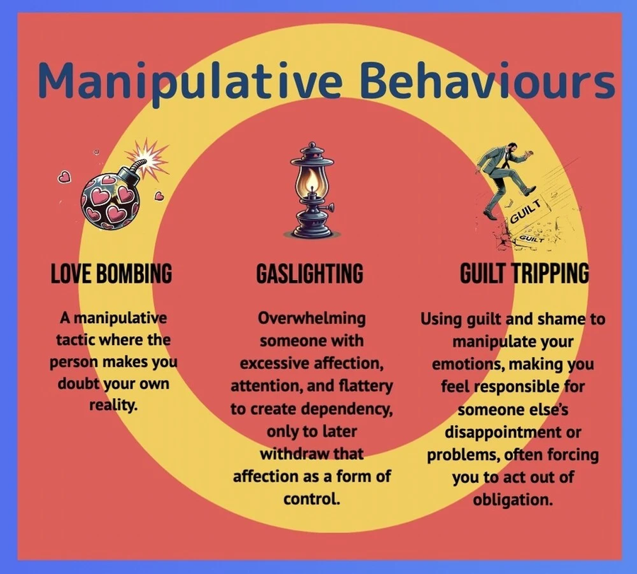
Emotional Manipulation

Slide 11

Making AI deepfakes

Slide 12
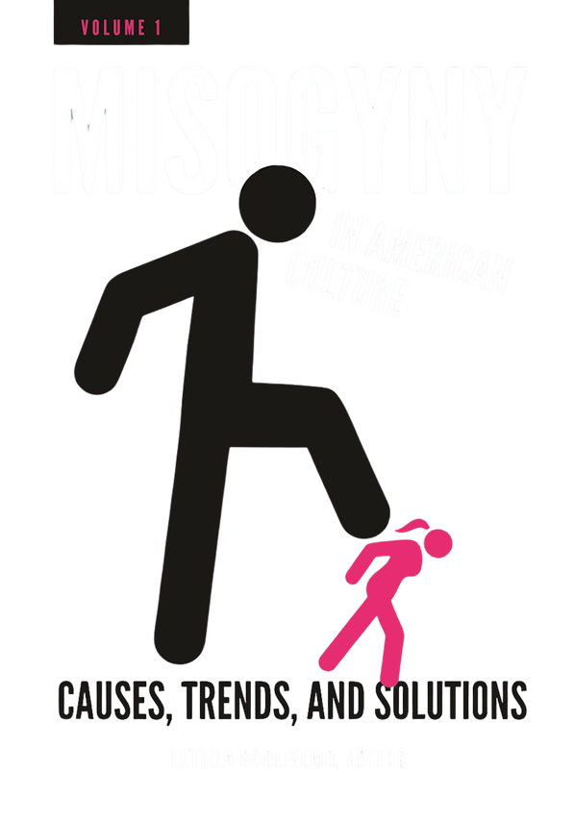
Misogyny
dislike of, contempt for, or ingrained prejudice against women.

Slide 13
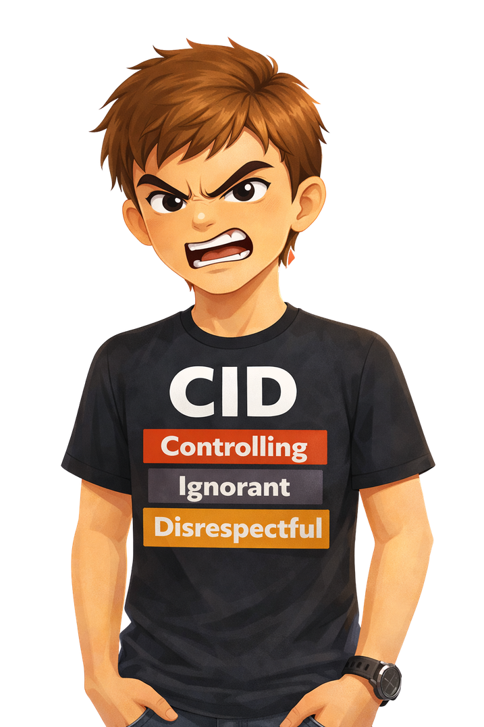
Meet CID
  Controlling: Its his way or the highway - he controls everything.
  Ignorant - he does not care about anybody else has to say.
  Disrespectful - he has no respect for anyone.
Notes:
CID = Controlling, Ignorant, Disrespectful
CID is not “bad moods” or “rough edges”. It’s the behavioural engine that drives bullying, harassment, coercion and eventually abuse if it’s left unchallenged.
This is the pattern, not the person.
C — CONTROLLING
What it looks like in children and teens
Deciding who is “allowed” to be in the group.
Telling others how to dress, speak, act or who to sit with.
Using guilt, sulking or threats to get their own way.
Overreacting to loss of control. shouting, walking off, intimidating body language.
Adult trajectory
This is the seed of coercive control.
Later it becomes monitoring phones, isolating partners, “I just worry about you” disguised as care.
Trainer lens
Control is not about anger.
It’s about power.
I — IGNORANT
Ignorant does not mean stupid.
It means emotionally and socially under-developed.
What it looks like
Laughing when someone is upset.
“It was only a joke” after harm is done.
Dismissing feelings. “You’re too sensitive.”
No curiosity about impact.
Adult trajectory
This becomes minimising abuse, blaming victims, normalising cruelty.
Trainer lens
Ignorance survives in cultures where empathy is optional.
D — DISRESPECTFUL
What it looks like
Name-calling.
Public embarrassment.
Online pile-ons.
Talking over others.
Treating people as objects, entertainment, or property.
Adult trajectory
This is where misogyny, entitlement and harassment live.
Trainer lens
Disrespect is rehearsed behaviour. It spreads socially, not genetically.
The CID Cycle
Control gets laughs or compliance.
Ignorance protects ego.
Disrespect gains status.
Repeat until it becomes identity.
Why CID Matters in Violence Prevention
Violence is rarely the first step.
It is the last stop on a long road of tolerated CID behaviour.
If you don’t interrupt:
controlling language at 10,
humiliating jokes at 13,
entitlement at 15,
you inherit coercion at 25.
How Trainers Intervene
Do not shame.
Do not moralise.
Interrupt patterns.
Use language like:
“That’s controlling, not leadership.”
“That joke landed badly. Let’s rewind.”
“Respect is how power is shared.”
You’re not fixing kids.
You’re re-writing scripts.
And that is how cultures actually change.

Slide 14

Meet Creepy Mc Creep
  Target you / take advance of you
  Person who spikes drinks in clubs
  Person who creeps about parks waiting to pounce
Notes:
CID = Controlling, Ignorant, Disrespectful
CID is not “bad moods” or “rough edges”. It’s the behavioural engine that drives bullying, harassment, coercion and eventually abuse if it’s left unchallenged.
This is the pattern, not the person.
C — CONTROLLING
What it looks like in children and teens
Deciding who is “allowed” to be in the group.
Telling others how to dress, speak, act or who to sit with.
Using guilt, sulking or threats to get their own way.
Overreacting to loss of control. shouting, walking off, intimidating body language.
Adult trajectory
This is the seed of coercive control.
Later it becomes monitoring phones, isolating partners, “I just worry about you” disguised as care.
Trainer lens
Control is not about anger.
It’s about power.
I — IGNORANT
Ignorant does not mean stupid.
It means emotionally and socially under-developed.
What it looks like
Laughing when someone is upset.
“It was only a joke” after harm is done.
Dismissing feelings. “You’re too sensitive.”
No curiosity about impact.
Adult trajectory
This becomes minimising abuse, blaming victims, normalising cruelty.
Trainer lens
Ignorance survives in cultures where empathy is optional.
D — DISRESPECTFUL
What it looks like
Name-calling.
Public embarrassment.
Online pile-ons.
Talking over others.
Treating people as objects, entertainment, or property.
Adult trajectory
This is where misogyny, entitlement and harassment live.
Trainer lens
Disrespect is rehearsed behaviour. It spreads socially, not genetically.
The CID Cycle
Control gets laughs or compliance.
Ignorance protects ego.
Disrespect gains status.
Repeat until it becomes identity.
Why CID Matters in Violence Prevention
Violence is rarely the first step.
It is the last stop on a long road of tolerated CID behaviour.
If you don’t interrupt:
controlling language at 10,
humiliating jokes at 13,
entitlement at 15,
you inherit coercion at 25.
How Trainers Intervene
Do not shame.
Do not moralise.
Interrupt patterns.
Use language like:
“That’s controlling, not leadership.”
“That joke landed badly. Let’s rewind.”
“Respect is how power is shared.”
You’re not fixing kids.
You’re re-writing scripts.
And that is how cultures actually change.

Slide 15

What can we do to STOP
CID behaviour?
Notes:
Group Activity
“What Can We Do to STOP CID Behaviour?”
Age: 9–14
Time: 15–25 minutes
Group size: 4–6 learners per team
Purpose: Move young people from spotting harm to changing it using GENT & LADIES behaviours.
How It Works
Each group is given a card that shows a real-life situation where CID behaviour is happening.
We never ask, “What’s wrong with this scenario?”
We ask:
“What can we do to STOP CID behaviour?”
This reframes young people from observers into changemakers.
Step-by-Step
1️⃣ Set the Rules (2 mins)
Explain:
CID = Controlling, Ignorant, Disrespectful
GENT and LADIES are tools, not labels
We’re fixing the behaviour, not attacking people
2️⃣ Give Each Group a CID Situation (5 mins)
Example cards:
Someone is being pushed out of a group chat
A player is laughed at after making a mistake
A boy shouts at a girl when he loses
Someone keeps asking for photos after being told no
A rumour is spreading about a girl
3️⃣ The Task (7–10 mins)
Each group must answer three questions:
What CID behaviour do you see?
Is it controlling, ignorant or disrespectful?
How would a GENT respond?
Which GENT value could stop this?
How would a LADIES leader respond?
Which LADIES value could change the situation?
They write or draw their answers.
4️⃣ Share & Reflect (5 mins)
Groups feedback one action each.
You reinforce with language like:
“That’s how CID gets interrupted.”
“You didn’t attack the person, you changed the behaviour.”
What This Teaches
Harm is not inevitable.
Behaviour can be challenged safely.
Boys and girls have active roles in preventing harm.
GENT and LADIES are tools for leadership, not personality types.
Why This Works
Children stop thinking:
“That’s just how people are.”
They start thinking:
“That behaviour can be stopped.”
That shift is prevention.

Slide 16
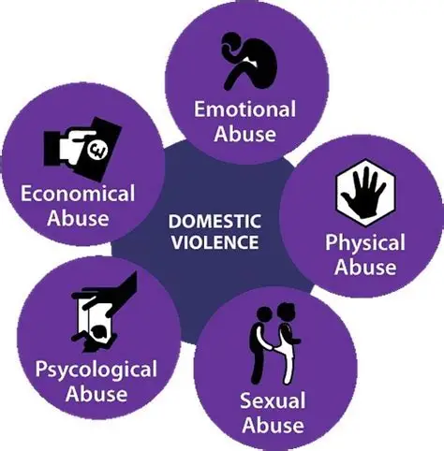
Types of abuse
Notes:
Group Activity
“What Can We Do to STOP CID Behaviour?”
Age: 9–14
Time: 15–25 minutes
Group size: 4–6 learners per team
Purpose: Move young people from spotting harm to changing it using GENT & LADIES behaviours.
How It Works
Each group is given a card that shows a real-life situation where CID behaviour is happening.
We never ask, “What’s wrong with this scenario?”
We ask:
“What can we do to STOP CID behaviour?”
This reframes young people from observers into changemakers.
Step-by-Step
1️⃣ Set the Rules (2 mins)
Explain:
CID = Controlling, Ignorant, Disrespectful
GENT and LADIES are tools, not labels
We’re fixing the behaviour, not attacking people
2️⃣ Give Each Group a CID Situation (5 mins)
Example cards:
Someone is being pushed out of a group chat
A player is laughed at after making a mistake
A boy shouts at a girl when he loses
Someone keeps asking for photos after being told no
A rumour is spreading about a girl
3️⃣ The Task (7–10 mins)
Each group must answer three questions:
What CID behaviour do you see?
Is it controlling, ignorant or disrespectful?
How would a GENT respond?
Which GENT value could stop this?
How would a LADIES leader respond?
Which LADIES value could change the situation?
They write or draw their answers.
4️⃣ Share & Reflect (5 mins)
Groups feedback one action each.
You reinforce with language like:
“That’s how CID gets interrupted.”
“You didn’t attack the person, you changed the behaviour.”
What This Teaches
Harm is not inevitable.
Behaviour can be challenged safely.
Boys and girls have active roles in preventing harm.
GENT and LADIES are tools for leadership, not personality types.
Why This Works
Children stop thinking:
“That’s just how people are.”
They start thinking:
“That behaviour can be stopped.”
That shift is prevention.

Slide 17
5 Ds Bystander Intervention
Overview of the 5 Ds
Distract: This method involves interrupting the situation without directly confronting the harasser. For example, you might engage the person being harassed in conversation or ask for directions, effectively diverting attention away from the harassment.
Delegate: If you feel uncomfortable intervening directly, you can seek help from others. This could involve alerting a friend, a staff member, or security personnel to the situation, ensuring that someone else can take action.
Document: In cases where immediate intervention isn't possible, documenting the incident can be crucial. This involves taking notes, photos, or videos of the harassment, which can be useful for reporting the incident later.
Delay: If the situation allows, you can check in with the person who was harassed after the incident. This can provide them with support and help them feel safe, as well as give them an opportunity to talk about what happened.
Direct: This approach involves addressing the behavior head-on. You can calmly tell the harasser that their behavior is inappropriate or make it clear that you do not support their actions. This method is most effective when you feel safe and confident in doing so.
Notes:
Group Activity
“What Can We Do to STOP CID Behaviour?”
Age: 9–14
Time: 15–25 minutes
Group size: 4–6 learners per team
Purpose: Move young people from spotting harm to changing it using GENT & LADIES behaviours.
How It Works
Each group is given a card that shows a real-life situation where CID behaviour is happening.
We never ask, “What’s wrong with this scenario?”
We ask:
“What can we do to STOP CID behaviour?”
This reframes young people from observers into changemakers.
Step-by-Step
1️⃣ Set the Rules (2 mins)
Explain:
CID = Controlling, Ignorant, Disrespectful
GENT and LADIES are tools, not labels
We’re fixing the behaviour, not attacking people
2️⃣ Give Each Group a CID Situation (5 mins)
Example cards:
Someone is being pushed out of a group chat
A player is laughed at after making a mistake
A boy shouts at a girl when he loses
Someone keeps asking for photos after being told no
A rumour is spreading about a girl
3️⃣ The Task (7–10 mins)
Each group must answer three questions:
What CID behaviour do you see?
Is it controlling, ignorant or disrespectful?
How would a GENT respond?
Which GENT value could stop this?
How would a LADIES leader respond?
Which LADIES value could change the situation?
They write or draw their answers.
4️⃣ Share & Reflect (5 mins)
Groups feedback one action each.
You reinforce with language like:
“That’s how CID gets interrupted.”
“You didn’t attack the person, you changed the behaviour.”
What This Teaches
Harm is not inevitable.
Behaviour can be challenged safely.
Boys and girls have active roles in preventing harm.
GENT and LADIES are tools for leadership, not personality types.
Why This Works
Children stop thinking:
“That’s just how people are.”
They start thinking:
“That behaviour can be stopped.”
That shift is prevention.

Slide 18
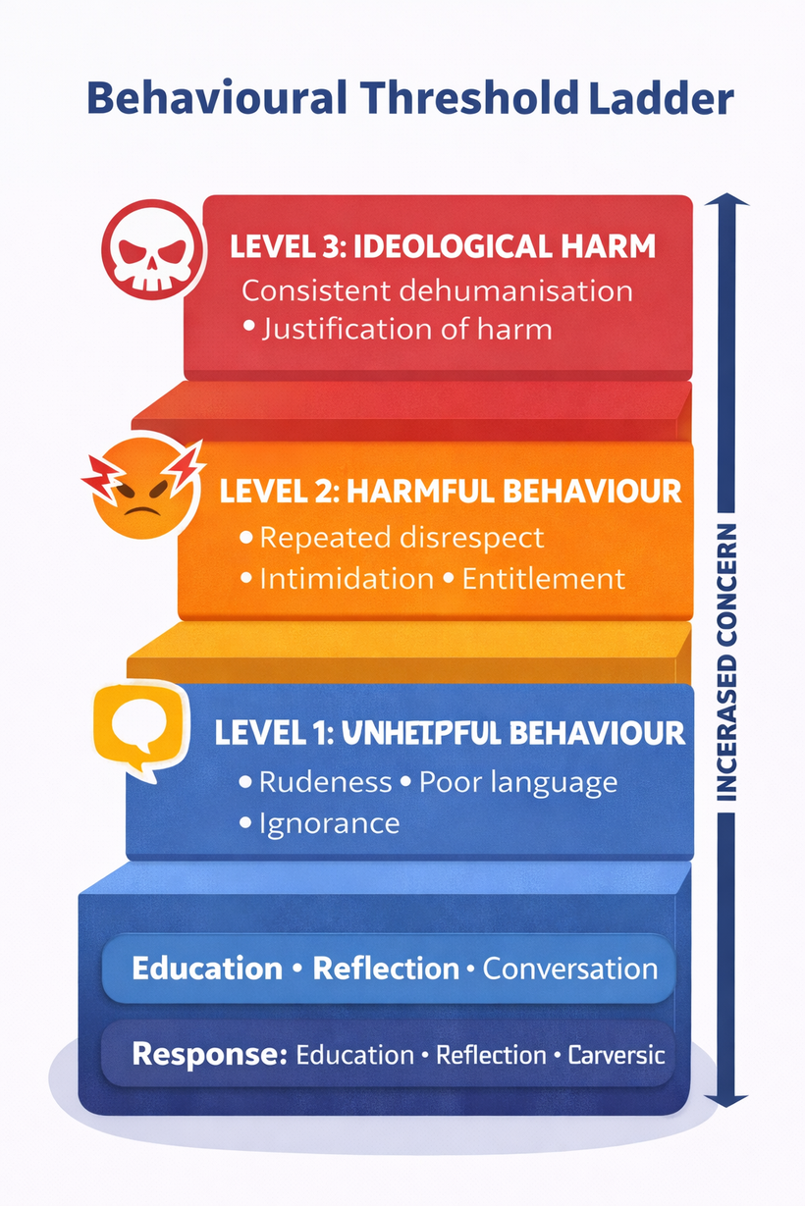


We can tackle through education

Slide 19
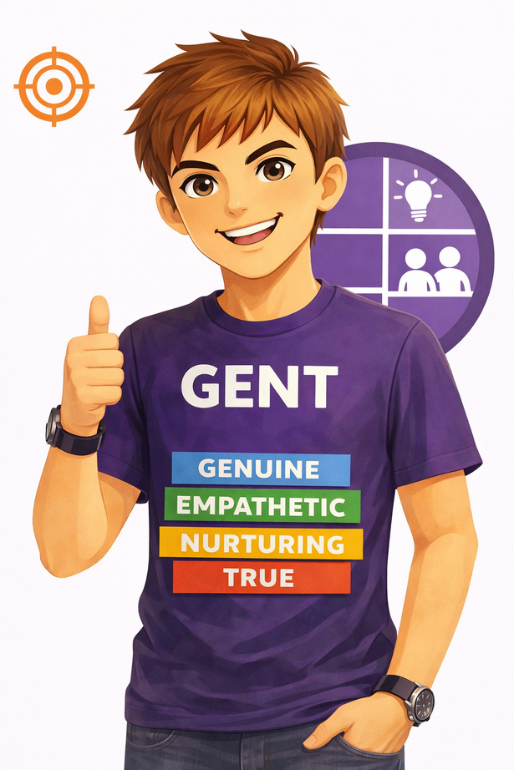
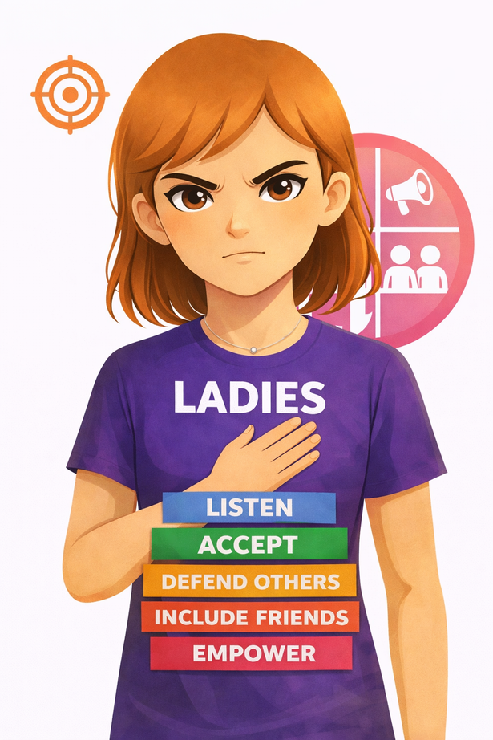

TAMHI Twins
Non Violent

Slide 20
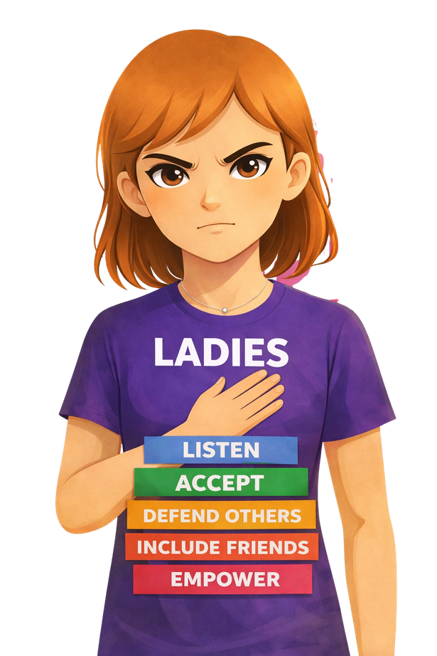
LADIES – How Young Girls Lead in Relationships
L – Listen
Pay attention to how people feel. If a friend seems upset or quiet, check in.
A – Accept/Assertive
Everyone is different. Accept yourself and others just the way they are. No Means NO. You do not need permission to say what you need to say.
D – Defend
If you or someone is being picked on, speak up, stand up agisnt it , do not accept disrespect
I – Include
Do not keep things to yourself - tell others if someone is being toxic - there is no shame , you will need help , you could be the help
E – Empower
Say kind things, encourage friends, and help people feel brave and confident.
Notes:
LADIES – How Young Girls Lead in Relationships
A framework for developing confidence, safety and social leadership
L – Listen
This is not passive listening.
It’s developing the ability to read situations, notice shifts in tone, and trust internal signals when something feels off.
Girls are often socialised to ignore discomfort to keep the peace. LADIES teaches them to treat their feelings as valid information, not inconvenience.
Adult aim: Build emotional literacy and early risk recognition.
A – Accept
Acceptance is about resisting comparison culture and internalised judgement.
This is where we tackle shame, body criticism, peer pressure and conformity without naming ideology. Girls learn that difference is normal and that self-worth isn’t earned through approval.
Adult aim: Reduce vulnerability to control by strengthening identity.
D – Defend
Defending is not confrontation training.
It’s boundary-setting, help-seeking, and refusing to normalise harm.
Girls learn when to speak up, when to step away, and when to bring in support. This reframes safety as strength, not weakness.
Adult aim: Replace silence with safe assertion.
I – Include
Inclusion is peer leadership.
This addresses relational aggression, exclusion, gossip and social hierarchies. Girls learn how everyday choices shape group culture and who feels protected or isolated.
Adult aim: Shift social power away from cruelty toward solidarity.
E – Empower
Empowerment is teaching girls to see themselves as capable actors, not passive recipients of behaviour.
This is about encouragement, ambition, collective confidence and modelling respect for themselves and others.
Adult aim: Build long-term resilience and leadership capacity.
Bottom line
LADIES is not about making girls behave.
It’s about giving them the tools to navigate power, protect dignity and lead culture change from childhood.

Slide 21
GENT – How Boys Show Respect
G – Genuine
Be real and honest. Treat people the way you want to be treated.
E – Empathy
Notice when someone feels sad or left out and try to help.
N – Non Violent
Look after your friends. Encourage people and help them feel safe. Never uses violence against anyone (unless self defence / fighting sports controlled environment)
T – Trustworthy
Keep promises, don’t spread lies, and be someone people can rely on.
Non Violent
Notes:
GENT, written for adults who understand this isn’t about manners. It’s about re-shaping masculine identity before it calcifies into entitlement or silence.
GENT – How Boys Learn Respect
A framework for developing healthy masculinity, responsibility and peer leadership
G – Genuine
This is about integrity, not niceness.
Boys learn to align who they are in private with who they are in public. No performative toughness, no audience-dependent behaviour, no status games at the expense of others.
This challenges the “be one person with the lads and another in front of adults” split that protects harm.
Adult aim: Build congruence between values and actions.
E – Empathy
Empathy is not softness.
It is situational awareness.
Boys learn to notice emotional cues, discomfort, silence, or withdrawal in peers. This is the foundation of consent, bystander intervention and non-violent leadership.
It also directly counters the emotional ignorance that underpins bullying and misogyny.
Adult aim: Develop emotional literacy without undermining confidence.
N – Nurturing
Nurturing reframes masculinity away from dominance toward protection and care.
This is not about becoming passive. It is about recognising that strength includes creating safe spaces, supporting teammates and taking responsibility for group culture.
It’s the bridge from aggression to guardianship.
Adult aim: Replace control with care.
T – Trustworthy
Trust is the social currency of leadership.
Boys learn that reliability, discretion and consistency are more powerful than bravado. This addresses gossip, betrayal and performative loyalty that fractures peer groups.
Trustworthiness is also where accountability lives.
Adult aim: Embed responsibility as a core masculine value.
Bottom line
GENT doesn’t ask boys to be less.
It asks them to be more deliberate, more responsible, and more aware of their impact.
That is how you prevent harm without shaming.

Slide 22
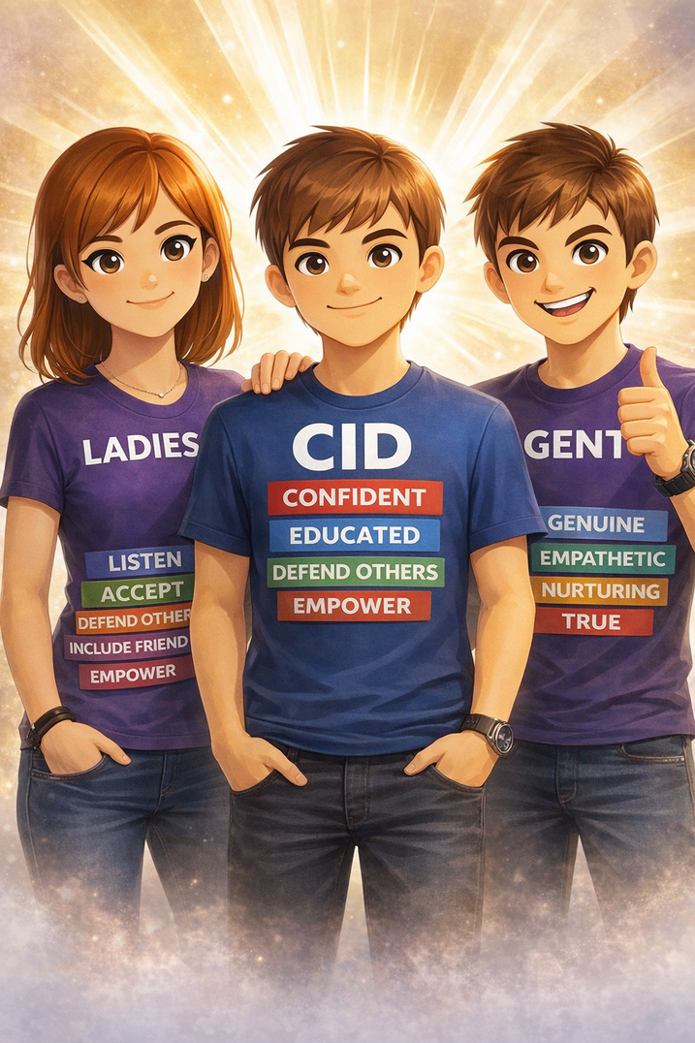
CID behaviours are choices, not identities.
They can be challenged, unlearned, and replaced.
That’s prevention.
That’s growth. And that’s how you stop harm without writing young people off.
Notes:
Why this matters:
Ignoring boundaries is a serious warning sign.
Group challenge:
What makes this unacceptable?
What’s the correct response after a “no”?
Positive behaviour to counter:
Accept boundaries immediately
Remove pressure
Respect consent without negotiation
Key learning:
“No” isn’t a challenge. It’s a full sentence.

