Slide 1



Notes:
Break the Silence
Hello. We are your School Ambassadors.
Today we will look at what bullying is and what it is not.
We will also explain how you can speak up safely.
Please do not name anyone during the assembly.
If anything worries you, speak to our ambassador team or a teacher.

Slide 2
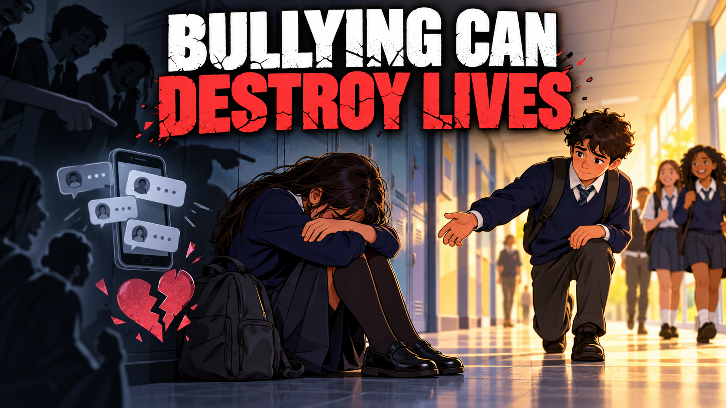
Notes:
Bullying can destroy lives.
Its important we “Break the silence” and speak up against unacceptable behavior.
That is why speaking up early matters.
Support is available, and nobody has to face bullying alone.
We want school to be a safe space for everyone.

Slide 3
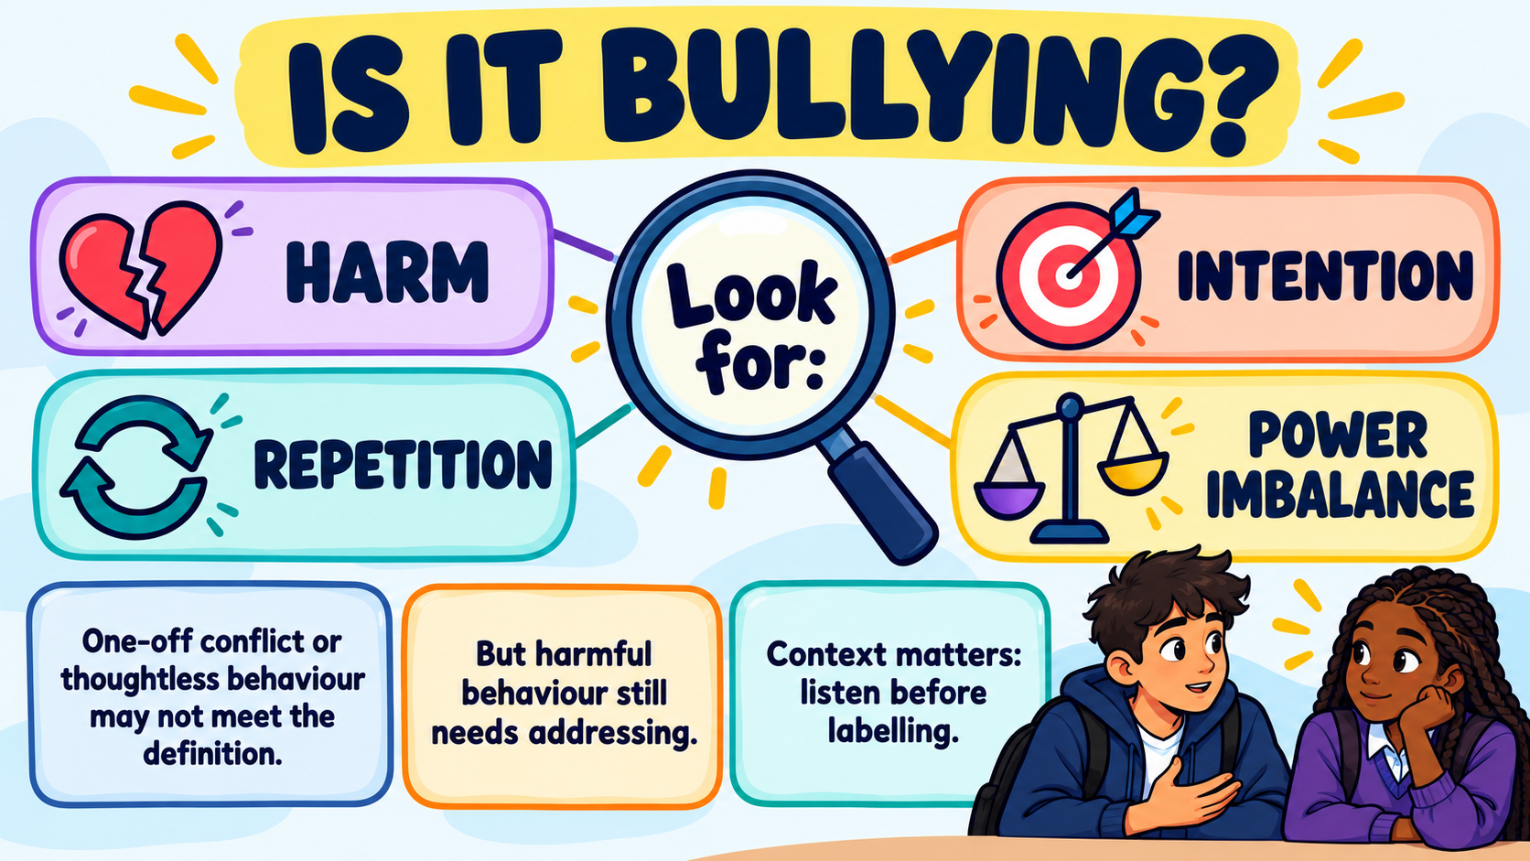
Look for: harm, repetition, intention, and a power imbalance.
One-off conflict or thoughtless behaviour may not meet the definition.
But harmful behaviour still needs addressing.
Context matters: listen before labelling.
Notes:
What Makes Behaviour Bullying?
Bullying is harmful behaviour that is usually repeated and deliberate.
There may be a power imbalance.
The number one intention is to cause hurt and harm.
This means the person finds it difficult to make the behaviour stop.
One argument or ignorant action may not be bullying.
However, harmful behaviour still needs to be addressed.

Slide 4
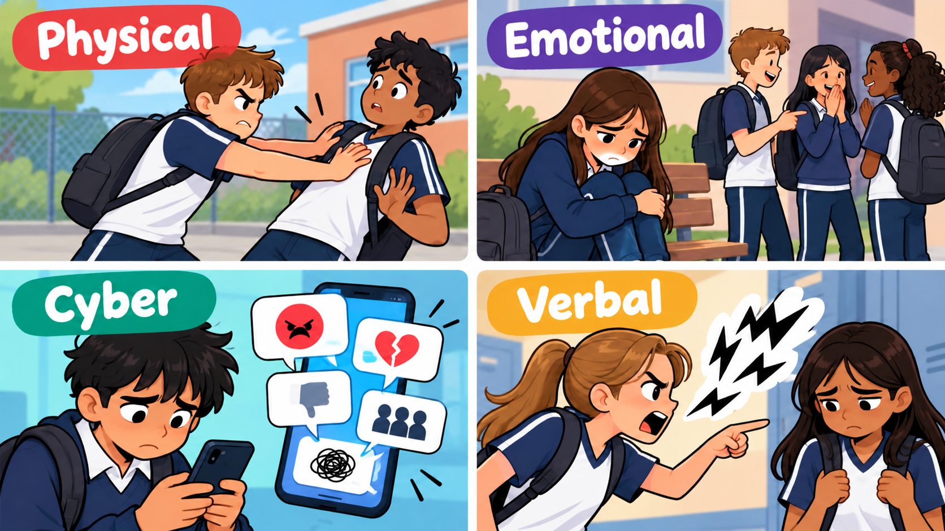

Notes:
Four Types of Bullying
Physical bullying includes:
hitting,
pushing
or damaging belongings.
Mental or emotional bullying includes:
humiliation,
rumours
and exclusion.
Cyberbullying:
happens through messages,
images,
gaming or social media.
Verbal bullying includes:
threats,
name-calling
and hurtful comments.
Different types of bullying can happen together.

Slide 5
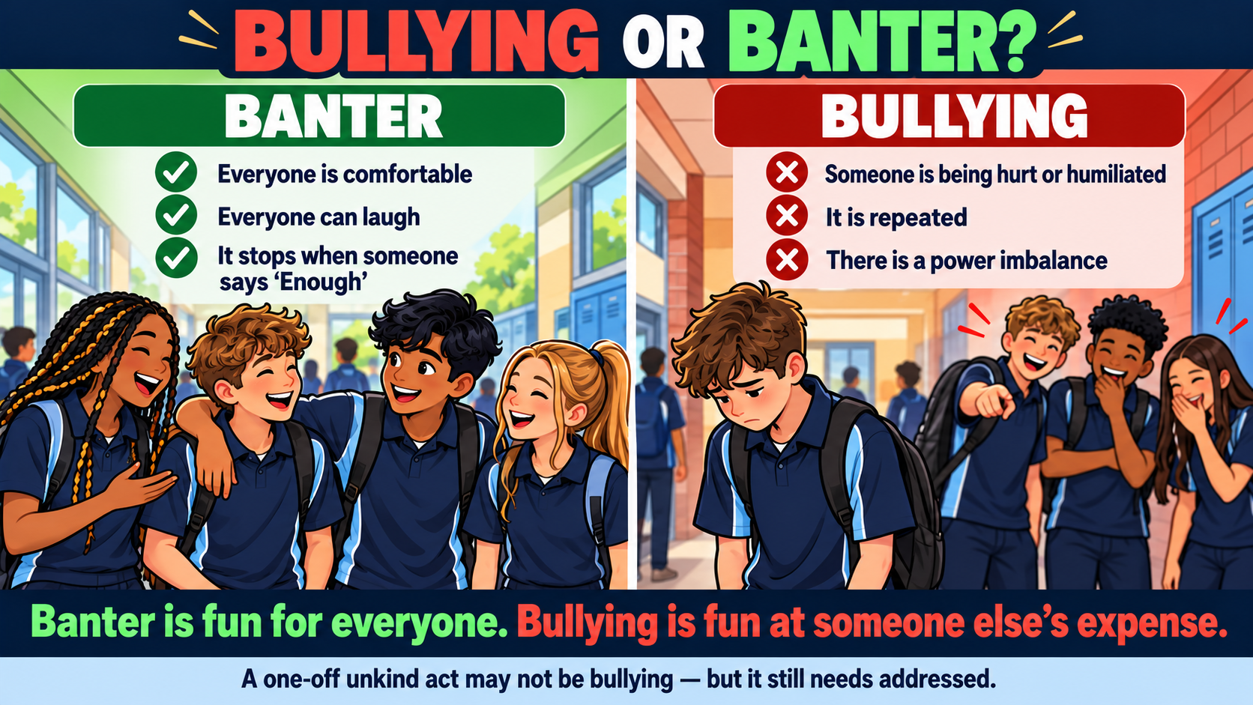
Notes:
Bullying or Banter?
Banter is friendly joking where everyone involved feels comfortable and can laugh. It stops when someone says, “That’s enough.”
Bullying is behaviour intended to hurt, embarrass, frighten or exclude someone.
It usually happens repeatedly and involves a power imbalance, making it difficult for the person to defend themselves.
Remember:
If everyone is laughing, it may be banter.
If someone is hurt, uncomfortable or being singled out, stop.
If it continues after they ask for it to stop, it is not banter.
Saying “I was only joking” does not excuse harmful behaviour.
A one-off disagreement may not be bullying—but it still needs to be addressed.
Banter is fun for everyone.
Bullying is fun at someone else’s expense.

Slide 6
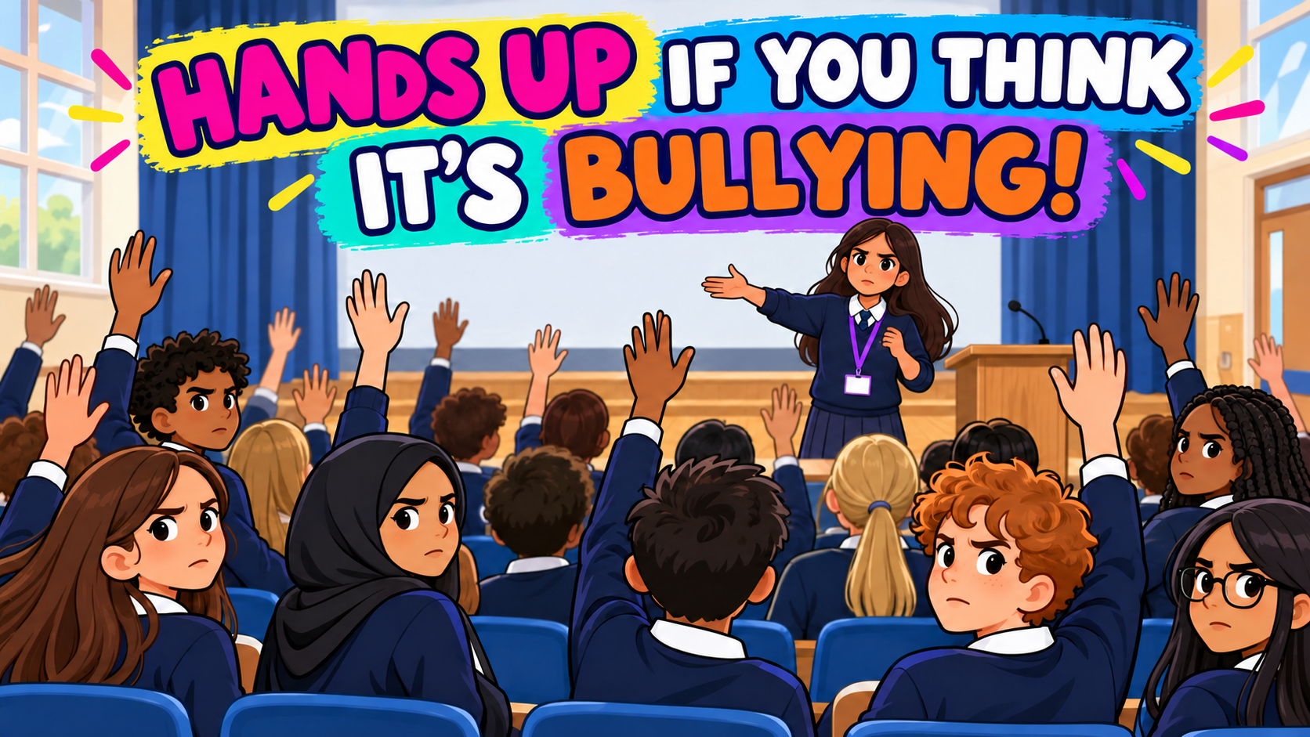
Is it Bullying?
Notes:
We will show you five different scenarios.
Put your hands up – IF YOU THINK ITS BULLYING?
You are not voting on whether the behaviour was nice.
You are deciding whether it meets the definition of bullying.

Slide 7
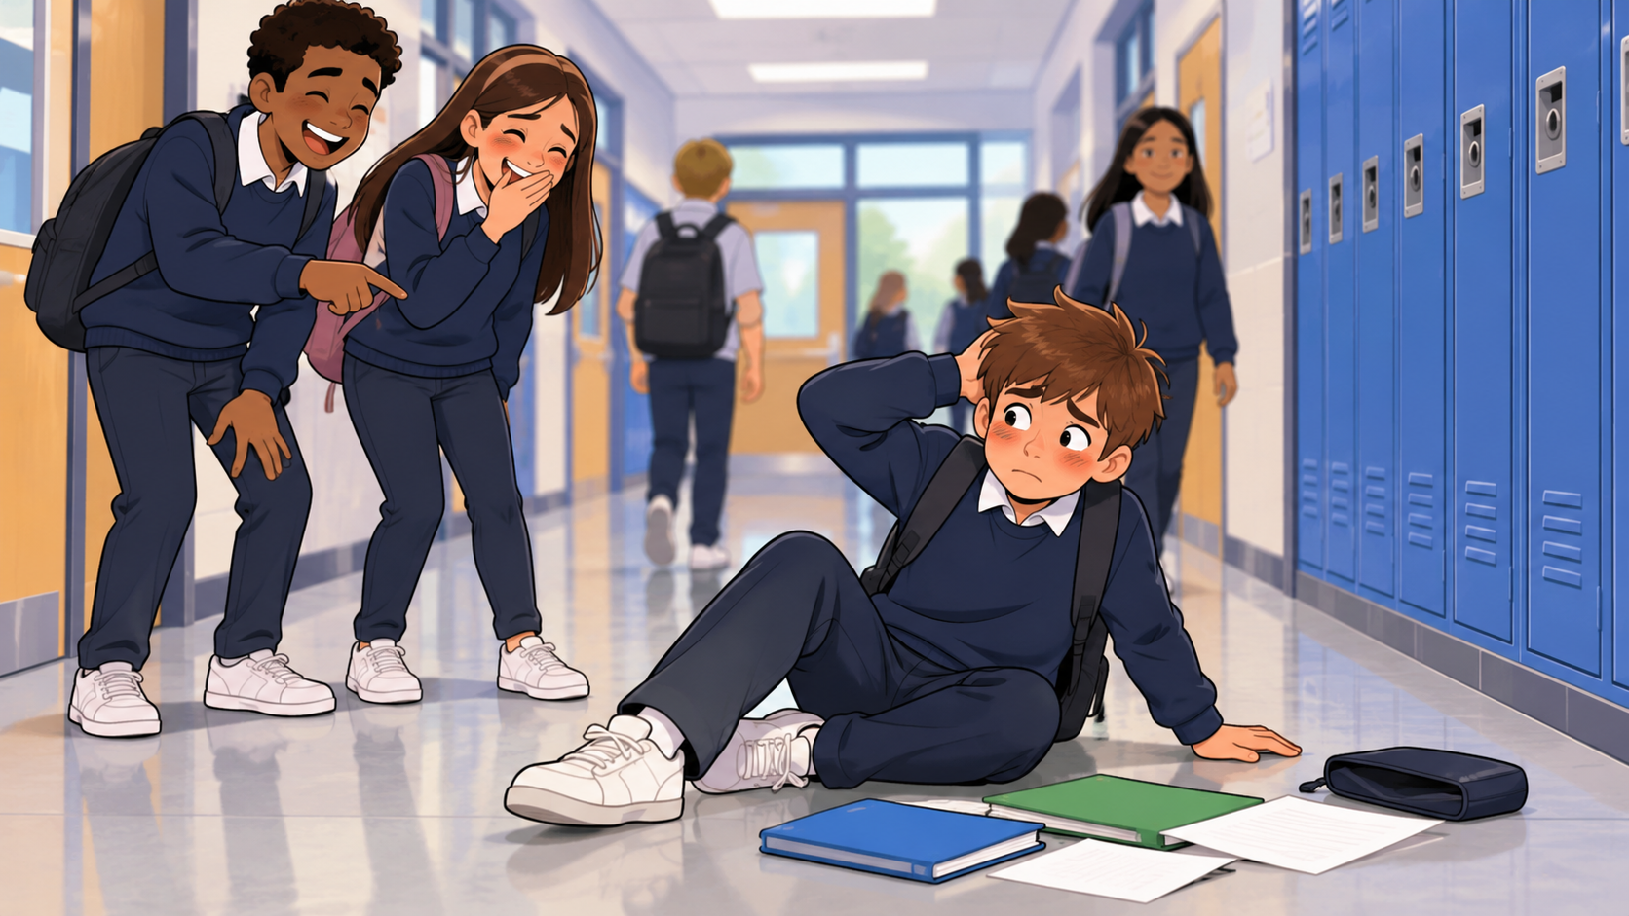
Scenario 1: Is this bullying? Friends Laugh when you trip over.
Notes:
A friend laughs when you trip over.
Is this bullying?
Think about whether it was deliberate or repeated.

Slide 8
A one-off laugh may be thoughtless , not targeted bullying.
If they keep humiliating you after you ask them to stop, the picture changes.
Is it Bullying?
Notes:
This is not bullying.
A one-off laugh may be thoughtless, but it is not automatically bullying.
Friends may laugh, but they should pick you up again.
It could still embarrass or upset the person.
If people repeatedly humiliate the person, it could become bullying.

Slide 9
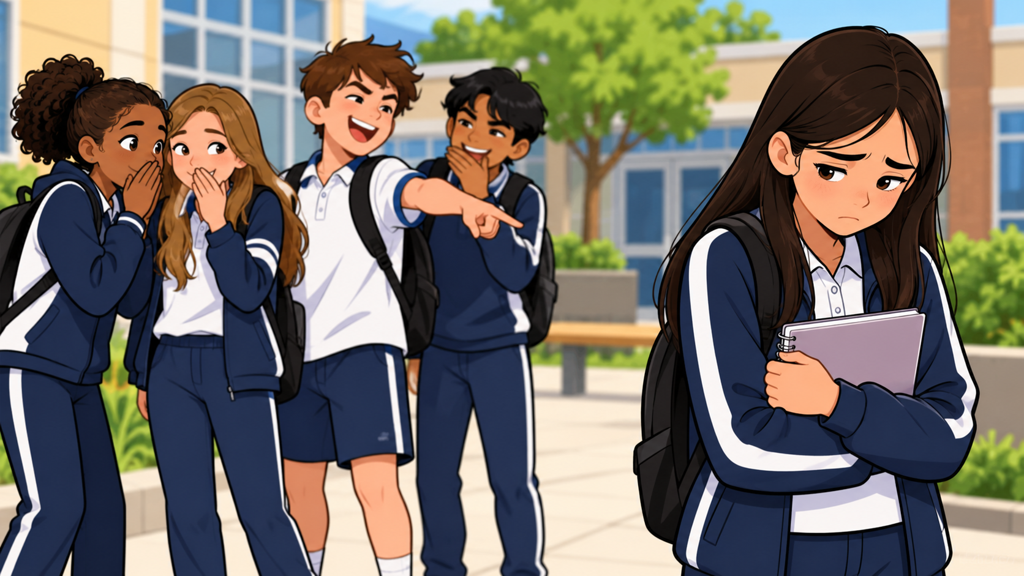
Scenario 2: Is this bullying? People are mean everyday and want to hurt you.
Notes:
People are mean to someone everyday.
They want to hurt and humiliate that person.
Is this bullying?

Slide 10
Yes – this is bullying
Repeated , deliberate humiliation which indicates bullying.
Tell a:
trusted adult,
Teacher,
or school ambassador.
Is it Bullying?
Notes:
The answer is—this is bullying.
It is harmful, deliberate and repeated.
The person should not deal with this alone.
They should tell a trusted adult or an Anti-Bullying Ambassador.
It can also help to write down what happened.

Slide 11
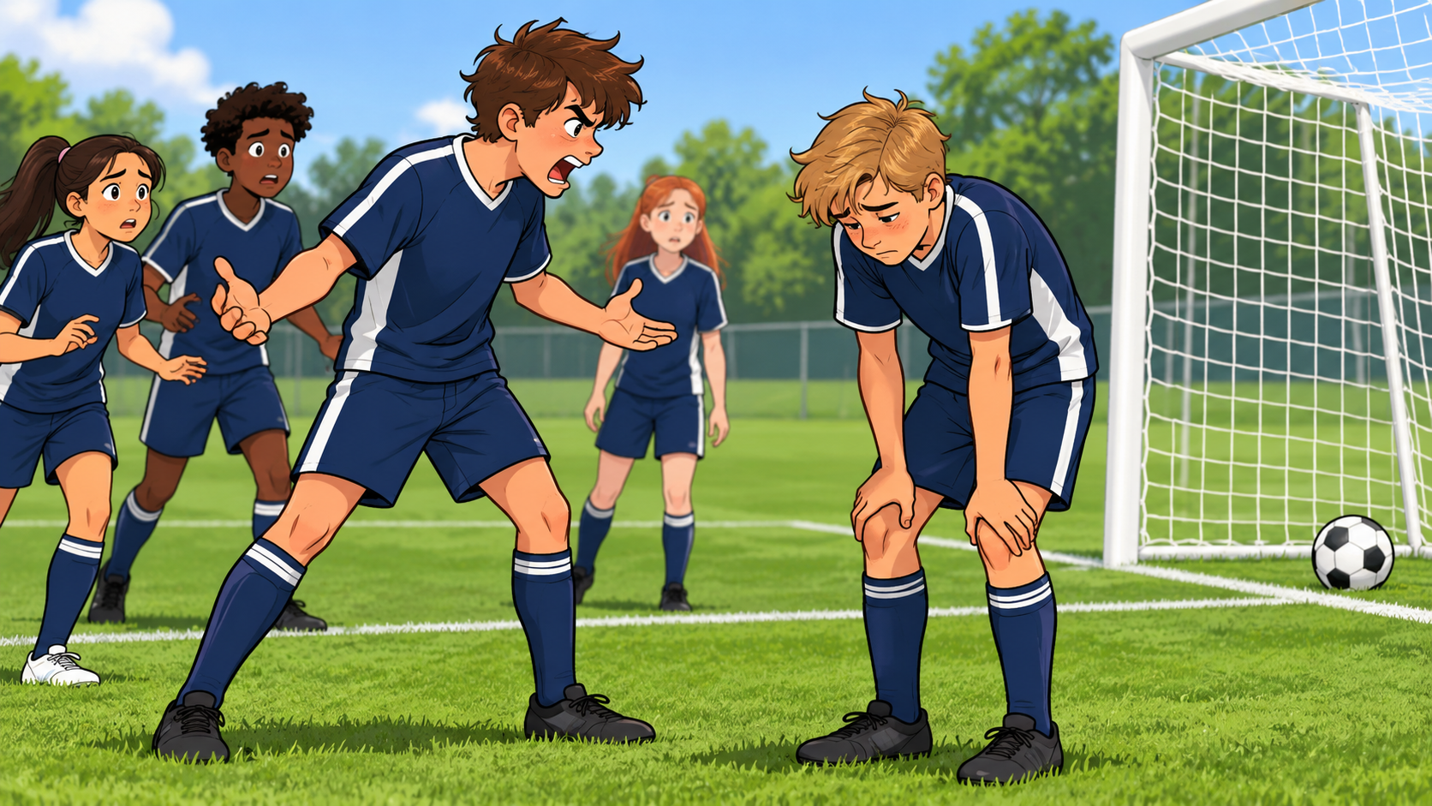
Scenario 3: Is this bullying? A Teammate shouts at you , after you miss an easy chance
Notes:
A teammate shouts at you after you miss an easy chance.
Is this bullying?
Think about whether it happened once or keeps happening.

Slide 12
Not necessarily bullying
A one-off frustrated reaction may not meet the definition, but it is still unacceptable..
Is it Bullying?
Notes:
The answer is, this is not necessarily bullying.
One frustrated reaction is not automatically bullying.
It is still not acceptable to shout at someone, but emotions can run high in sport.
If the player repeatedly targets or intimidates the same person, it could become bullying.
The coach should address the behaviour.

Slide 13
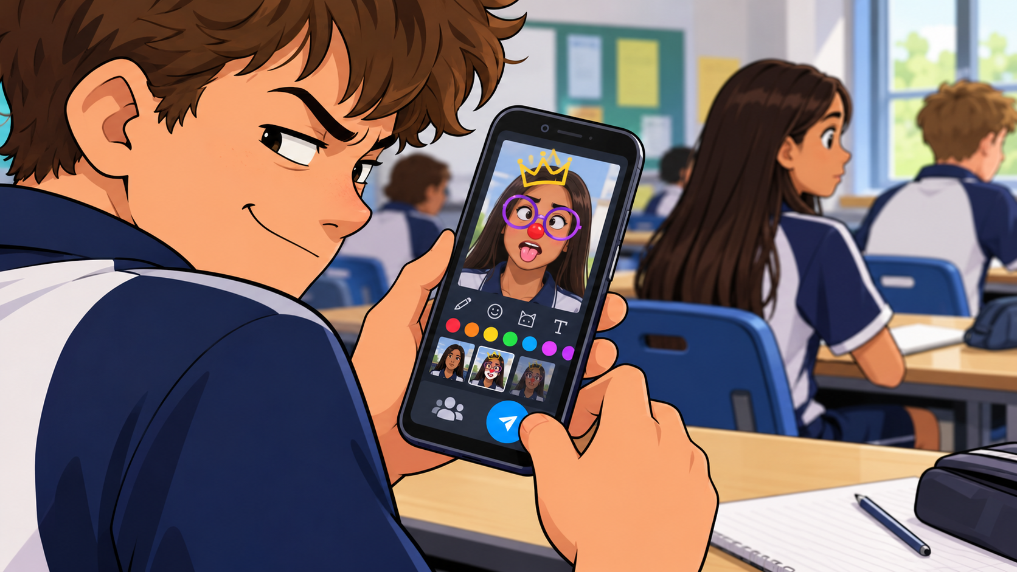
Scenario 4: Is this bullying? Someone makes AI images to share online.
Notes:
Someone creates a cruel AI image of another pupil.
They share it in group chats or on social media.
Is this bullying?

Slide 14
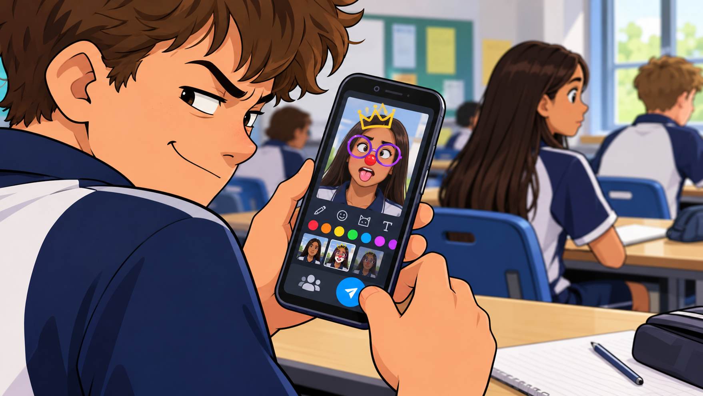
SERIOUS HARM: Bullying
No pictures should ever be used without consent.
Targeted sharing to shame or intimidate is cyberbullying.
Even on incident can be serious.
DO NOT reshare – report it.
Is it Bullying?
Notes:
This is cyberbullying. The image was created to cause harm and can be repeatedly viewed and shared.
Never create or share an image of someone to embarrass, intimidate or harm them.
One post can be viewed, copied and shared many times which is a key part of “repetition” which is aligned to bullying behaviour.
Do not like, comment on or reshare it.
Keep any evidence you already have and report it to a trusted adult.

Slide 15

Scenario 5: Is this bullying? Groups don’t include you.
Notes:
A group does not include someone in an activity.
Is this bullying?
Think about whether it happened once or is being done repeatedly to hurt them.

Slide 16
It depends
Not every friendship group or activity must include everyone.
Deliberate repeated exclusion intended to isolate or hurt someone may be bullying.
We have spaces and groups pupils can access over break and lunch to connect with others.
Is it Bullying?
Notes:
The answer is—it depends.
Not being included once is not automatically bullying.
Deliberately and repeatedly excluding someone to hurt them may be bullying.
Even when it is not bullying, the person may still feel lonely.
YOU NEED TO ADD WHAT YOUR SCHOOL OFFERS
Break Time Club / Zen Dens / Games Sessions – Dedicated Space for young people

Slide 17
Impact Matters
Bullying and other harmful behavior can:
affect belonging ,
confidence ,
learning
and mental wellbeing.
Its important we all be kind and supportive and look out for each other.
Start with our own class group.
Is it Bullying?
Notes:
Impact Matters
Bullying and other harmful behavior can:
affect belonging,
confidence ,
learning
and mental wellbeing.
Its important we all be kind and supportive and look out for each other.
Start with our own class group.

Slide 18
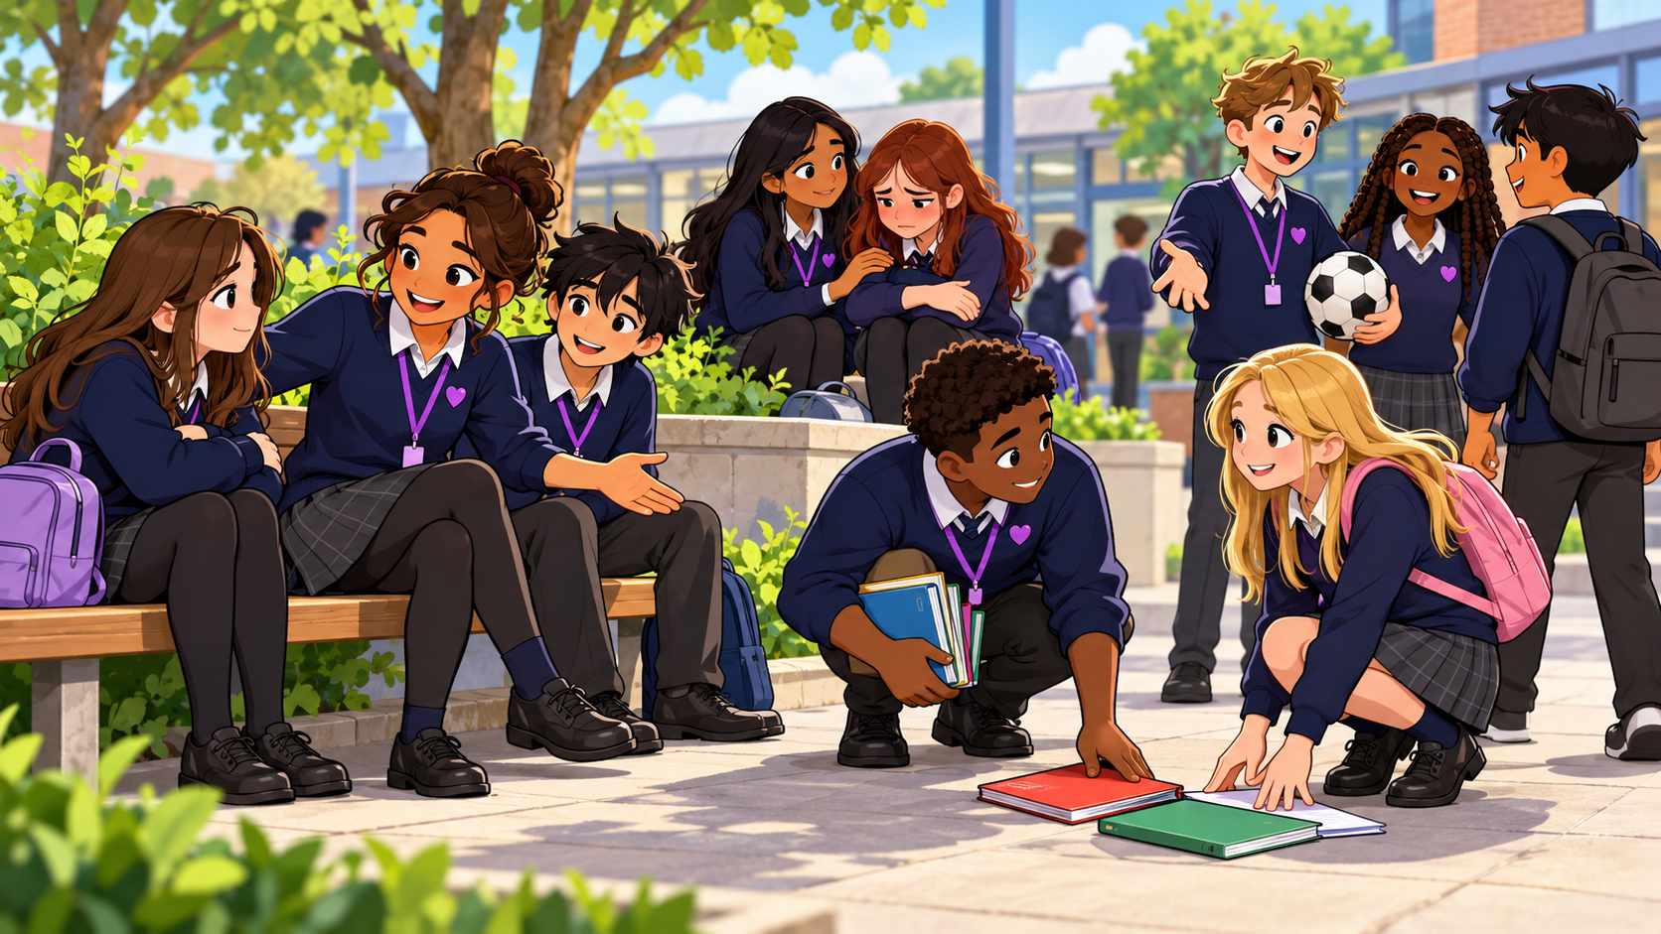
Notes:
We Are Your Anti-Bullying Ambassadors
We are here to listen and take your concerns seriously.
We will speak up when behaviour is hurtful, harmful or wrong.
We can support you to speak to the right trusted adult.
We cannot keep a safety concern secret because keeping you safe comes first.
We will not investigate incidents or confront anyone ourselves.
Our job is to help you feel heard, supported and able to get help.
You do not have to deal with bullying alone.

Slide 19
Break the silence safely
If you see it
Don’t join in,
Check with the person affected,
Report concerns to a teacher, safeguarding lead or a trusted adult,
Speak to our Ambassador team,
Write down what you saw or heard and keep any evidence.
Is it Bullying?
Notes:
Do not join in, laugh, like or reshare harmful content.
Check that the person is okay.
Tell a teacher, safeguarding lead or trusted adult.
You can also speak to a school Ambassador.
Write down what you saw or heard.
Keep any evidence you already have, but do not share it with other pupils.
Do not put yourself in danger by confronting someone alone.

Slide 20
Final Challenge
Think?
What would you do if your friend was being targeted?
What can your class do to support each other and promote kindness and understanding?
Actions:
Notice it ,
Support Someone and
Speak up safely
Is it Bullying?
Notes:
Think about what you would do if a friend was being targeted?
You do not have to solve the problem yourself.
You can support the person and help them speak to an adult.
Reporting bullying is not getting someone into trouble.
It is helping to keep someone safe.
Remember our three actions:
Notice it.
Support someone.
Speak up safely.
Thank you for listening.

